Slide 1


Accounting for Income Taxes
Items to be covered
  Deferred taxes
    Temporary vs. permanent differences
    deferred tax liabilities
    deferred tax assets
      valuation allowance
    presentation in financial statements
    future tax rates different from present
  Loss carrybacks/carryforward
  Intraperiod tax allocation
  Some issues/controversies
Notes:
1
25
25
25
2
2
2

Slide 2
Some general observations:
The Internal Revenue Code which governs the accounting for tax liability is not the same as GAAP which governs financial reporting.
As a result,
  taxable income reported to the IRS (using cash basis accounting) may not be the same as pre-tax profit that is reported to shareholders (using accrual accounting).
  The amount of tax liability due to the IRS may not be the same as income tax expense that is reported on the income statement.

Slide 3
We, therefore, speak of “book income” (meaning income reported to shareholders) and “tax income” (income reported to the IRS).
There may be Temporary differences between the two. That is, book income may be higher than tax income this year, but will be lower in a future year so that cumulative profit will be the same for both.
Or there may be Permanent differences between the two (e.g., the difference will not reverse) This is due to GAAP treating some items as income or expenses that the IRS does not, like municipal bond income that is treated as revenue under GAAP, but is not taxed by the IRS.
Notes:
6
25
25
25
2
2
2

Slide 4
As an example of the differences between book and tax income, consider a company that depreciates its assets using the straight-line method for financial reporting purposes and an accelerated method for tax purposes. This is typical for most companies. Assume that income before depreciation is $15,000. Pre-tax (financial reporting) and taxable (IRS) income might be reported as follows:
Pre-tax Taxable
Income before dep’n 15,000 15,000
Dep’n expense 2,000 3,000
Pre-tax/taxable income 13,000 12,000
Taxable income is lower than pre-tax income. We know, however, that over the life of the asset the same amount of depreciation expense will be reported under both methods. As a result, taxable income will be higher in future years and tax liability as well.

Slide 5
We know in the first year of the asset’s life that taxable income will be higher in future years when accelerated depreciation is less than straight-line. We also know that the company’s tax liability will be higher as well.
Since we know that a future tax liability exists and can compute its amount, we need to report it in the company’s balance sheet. This is the essence of deferred taxes.
A deferred tax liability must be accrued for the future tax liability (taxable income multiplied by the firm’s tax rate). This liability will remain on the company’s balance sheet until taxable income is, in fact, higher and the tax liability is paid.

Slide 6
It is now time to introduce a fundamental concept relating to income tax expense: under current GAAP, the expense reported in the income statement is equal to the sum of the tax liability currently payable plus the change in the deferred tax liability:
Taxable income
* Tax rate
= Tax liability
+ Change in deferred taxes
= Income tax expense for financial reporting purposes
Income tax expense is, therefore, a derived figure, the sum of current tax payment due to the IRS plus the change in deferred taxes. So, if we have deferred taxes, tax expense will not be equal to taxes paid.

Slide 7
For temporary differences, then, we can have either:
  Future taxable income (e.g., current reported profitability is higher than taxable income reported to the IRS, like in the depreciation example).
  Future deductible expenses (e.g., current reported profitability is lower than taxable income). An example of this that has become quite common are restructuring expenses. When firms restructure their operations they accrue expenses for severance, etc. that are not deductible for tax purposes until paid.
Notes:
7
25
25
25
2
2
2

Slide 8
Permanent differences only involve current year effects, that is, they do not reverse like the depreciation example. These relate to items that are treated differently under the tax code than they are under GAAP.
For example, municipal bond interest and a portion of the dividends received by a company on an investment in another company’s stock are not treated as revenue for tax purposes, but are recognized under GAAP. Also, amortization of Goodwill is usually not deductible unless the acquisition is treated as a taxable event.
The key point is that only temporary differences have implications for deferred taxes and income tax expense; permanent differences do not.
Notes:
8
25
25
25
2
2
2

Slide 9
Let’s look at a simple example
to get started.
(Click here to view an example of the accounting for deferred taxes)

Slide 10
Up to this point we have only considered the case of deferred tax liabilities, representing future taxable amounts. We also encounter situations in which companies report expenses currently under accrual accounting that will not be deductible for tax purposes until paid.
The most common example of this are restructuring expenses mentioned earlier. Severance expense is accrued when estimated and recognized currently in the financial statements. The IRS does not allow a deduction for these costs until they are actually paid.
In this case, pre-tax income is less than taxable income and the firm will realize a future deductible amount. This gives rise to deferred tax assets.

Slide 11
Try to work through an example involving deferred tax assets yourself….
Assume that a company accrues severance expense of $20,000 in 1999 for employees it expects to terminate in the following year. The $20,000 is paid in 2000. Profit before the accrual is $50,000 in both years. Assuming a 35% corporate income tax rate, how much tax expense should be reported in both years?
(Click here to view an example of the accounting for deferred tax assets)

Slide 12
The amount of the deferred tax asset or liability is computed as the amount of the future taxable income or the future tax deduction multiplied by the firm’s tax rate. In addition, these future taxable amounts or deductions can occur at any point in the future, not just in the next year as our examples have assumed thus far.
Which rate should we use to determine the tax effects of taxable and deductible amounts?
  Use the enacted rate for the years involved.
What if rates change?
  Measure deferred tax assets and liabilities using the new rates. This will result in an adjustment to current tax expense (and net income) in the year of the change.
Notes:
9
25
25
25
2
2
2

Slide 13
There is another question that arises concerning deferred tax assets. Remember, these relate to future deductible amounts. They are only benefits if the company is likely to realize future profitability against which it can deduct these expenses. If the company is not expected to generate profits in the periods it will deduct the costs, they are of no benefit and should not continue to be listed as assets.
If the firm is not expected to have taxable income in the
periods that the deductions are to be realized, the
deferred tax asset may not be recognized. In this case,
we need to set up a valuation allowance, similar to the
allowance for uncollectible accounts.
Notes:
11
25
25
25
2
2
2

Slide 14
If a valuation allowance is required, the company makes the following journal entry:
Income tax expense xxx
Allowance to reduce deferred tax
asset to expected realizable value xxx
The allowance account is netted from the deferred tax asset account on the balance sheet, so only the net realizable value is reported, just like accounts receivable.
As you can also see, the other effect of this entry is to increase income tax expense and reduce net profit.
Notes:
12
25
25
25
2
2
2

Slide 15
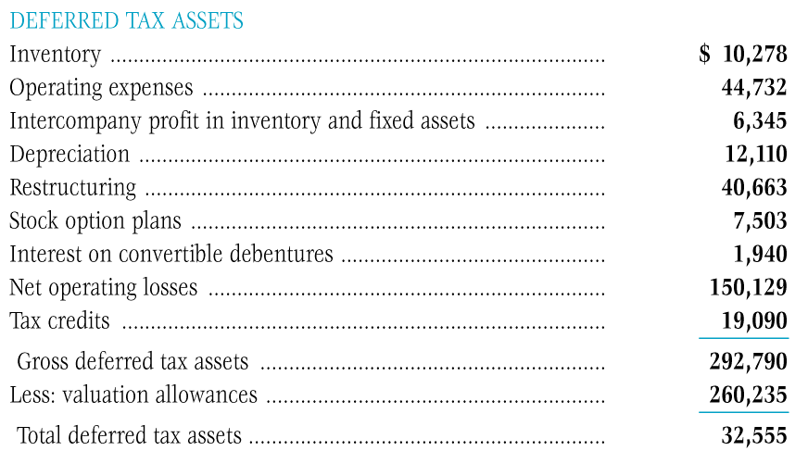
This is Data General’s footnote on deferred taxes. Notice that it has set up a valuation allowance of $260 million, 89% of the deferred tax asset account. Should it become evident that the future deductions will be utilized, it can reverse this allowance and increase profits by $260 million.

Slide 16
Loss carrybacks and loss carryforwards:
.
When a company realizes a net loss for tax purposes, the IRS allows it to offset this loss against prior year’s taxable income and to receive a refund for taxes paid in the past. It can carry these losses back up to 3 years. If the company does not have sufficient taxable income in the preceding 3 years to absorb these losses, it can carry the remaining losses forward for 15 years and deduct them against taxable income to be realized in the future.
(Click here to view an example relating to tax loss carrybacks and carryforwards.)
Notes:
13
25
25
25
2
2
2

Slide 17
Intraperiod tax allocation:
As we learned in our initial discussion about the income statement, companies report operating income, then adjust this amount for profit (losses) from discontinued operations, extraordinary items and/or changed in accounting principles.
Each of these “below the line” categories must be reported net of tax. That means that the total tax expense is allocated to each of income from continuing operations, discontinued operations, extraordinary items, and changes in accounting principles separately.
Notes:
16
25
25
25
2
2
2

Slide 18
The End

